Slide 1
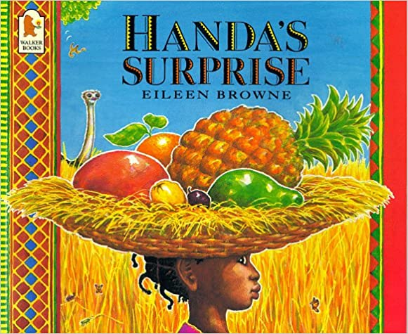
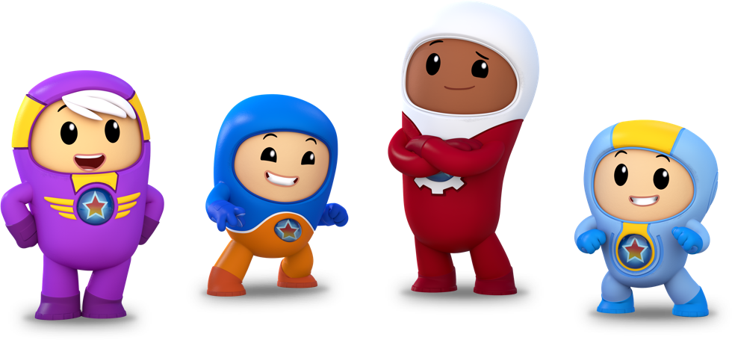
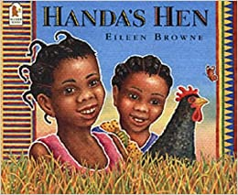
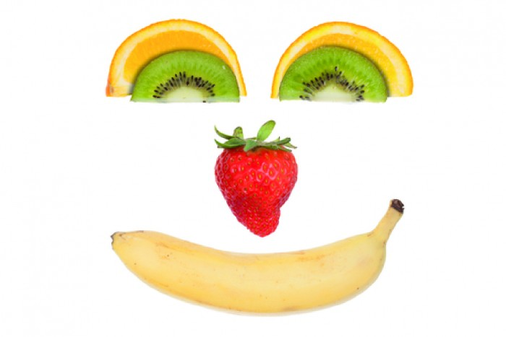
My Home Learning Journey. Handa’s Surprise
Special Task
Phonics/Literacy
Can you write a sentence about your favourite animal in the story? The animals are; Monkey, Ostrich, Zebra, Elephant, Giraffe, Antelope, Parrot and Goat
Remember to:
-Sound out each word using your ‘Robot arms’
-Use a phonics sound mat or phonics flashcards if you are unsure of the sounds
-Remember your finger spaces, capital letters and full stops.
Maths
How many fruits does Handa put in her basket? What is one less than 7,6,5,4,3,2,1? Can you split a fruit in half? Can you divide a piece of fruit into quarters? Can you share out some fruit equally between your family?
Can you tell your friends and teachers one fact that you have found out about Africa the continent that Handa lives in? You can do this by drawing a picture, writing a sentence or telling us about it on video. You can post it on the Parents What’s App group or email it to your teacher. Watch ‘Cbeebies Go Jetters Africa’ to help you.
Let’s get Physical!
Have you been for a walk this week? Go on a walk like Handa and count how many animals you spot on the way!
Can you make up your own dance to some African music? You can listen to music on YouTube Kids.
You can watch the story of Handa’s Surprise on Youtube and another story about Handa – ‘Handa’s Hen’
Can you make your own fruity face or fruit salad?

